Slide 1
dc motor with motor driver
We can control the speed of the DC motor by simply controlling the input voltage to the motor and the most common method of doing that is by using PWM signal.
The input voltage is control by motor driver which is mainly used for the
control the speed of motor and direction of motor.

Slide 2
Motor driver
PWM, or pulse width modulation is a technique which allows us to adjust the average value of the voltage that’s going to the electronic device by turning on and off the power at a fast rate.
The average voltage depends on the duty cycle, or the amount of time the signal is ON versus the amount of time the signal is OFF in a single period of time.

Slide 3
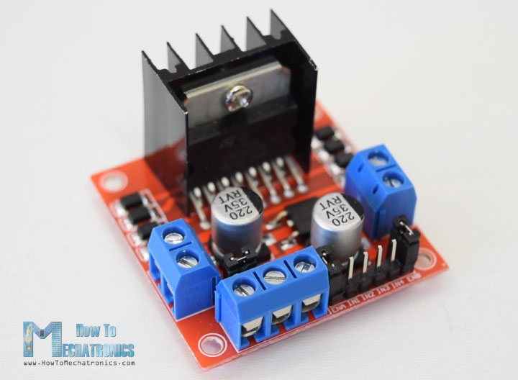
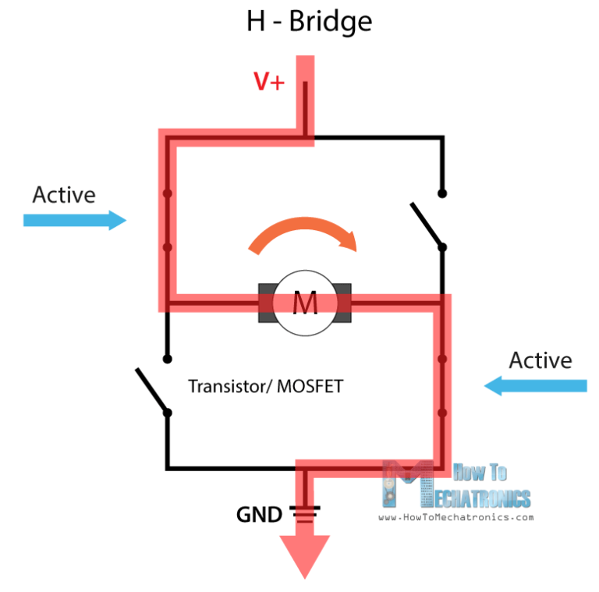
working principle of motor driver
The L298N is a dual H-Bridge motor driver which allows speed and direction control of two DC motors at the same time

Slide 4
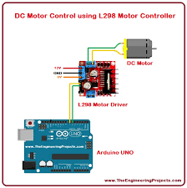
Connection diagram

Slide 5

It’s coding time

Slide 6
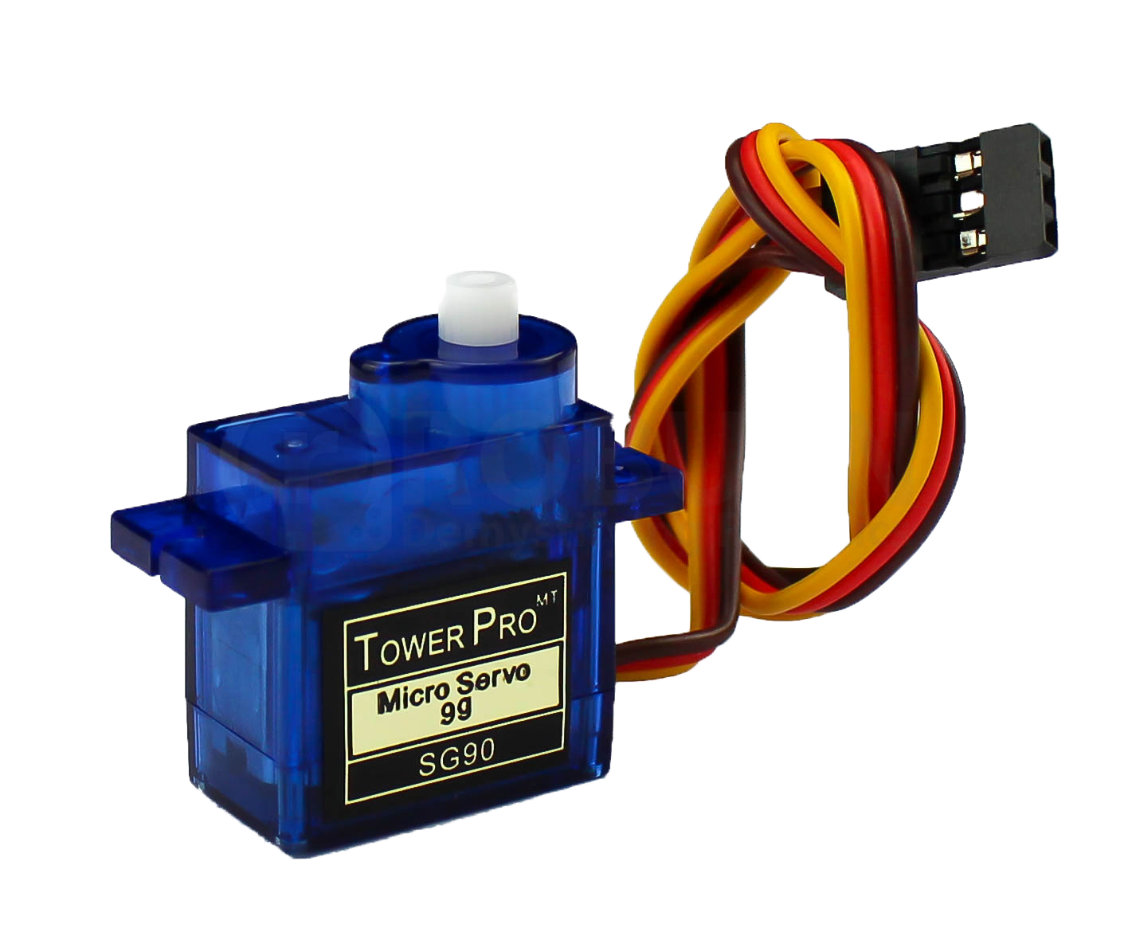
Servo motor
Servo motor works on PWM (Pulse width
modulation) principle, means its angle of
rotation is controlled by the duration of applied
pulse to its Control PIN

Slide 7
servo contd…..
Servo motor is used in the following field :
In Home security for door lock
Robotics: A servo motor at every "joint" of robot
is used to actuate movements, giving the robot
arm its precise angle.

Slide 8
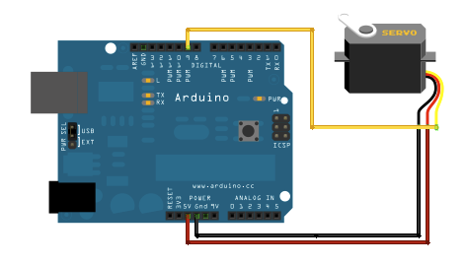
Connection diagram

Slide 9
It’s coding time

Slide 10
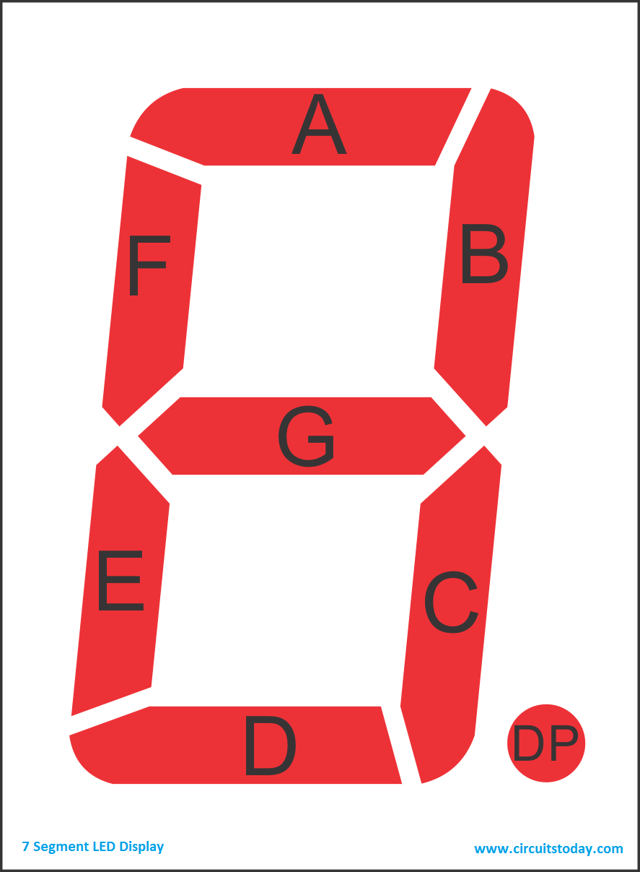
Seven segment
A seven-segment display (SSD) is a
widely used electronic display
device for displaying decimal
numbers from 0 to 9

Slide 11
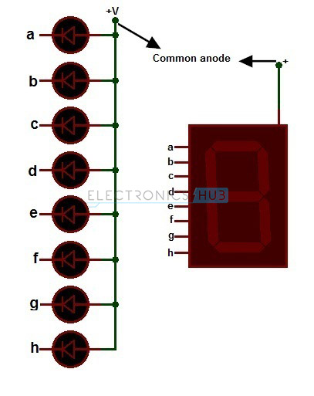

Slide 12
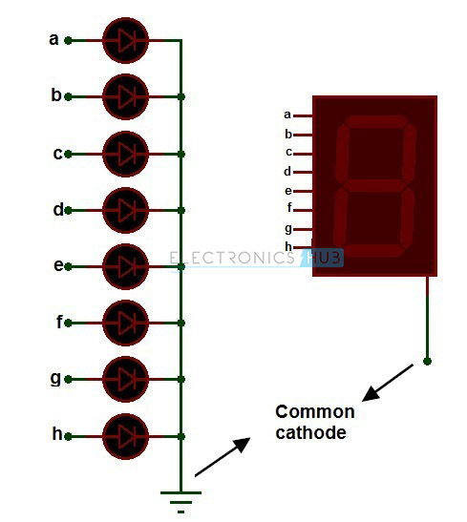

Slide 13
Seven segment
Seven-segment displays are widely used in digital clocks,
electronic meters, basic calculators, and other electronic
devices that display numerical information.

Slide 14
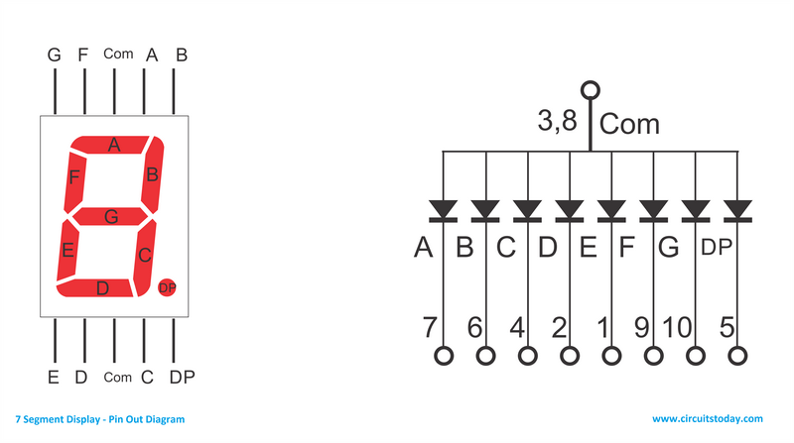

Slide 15
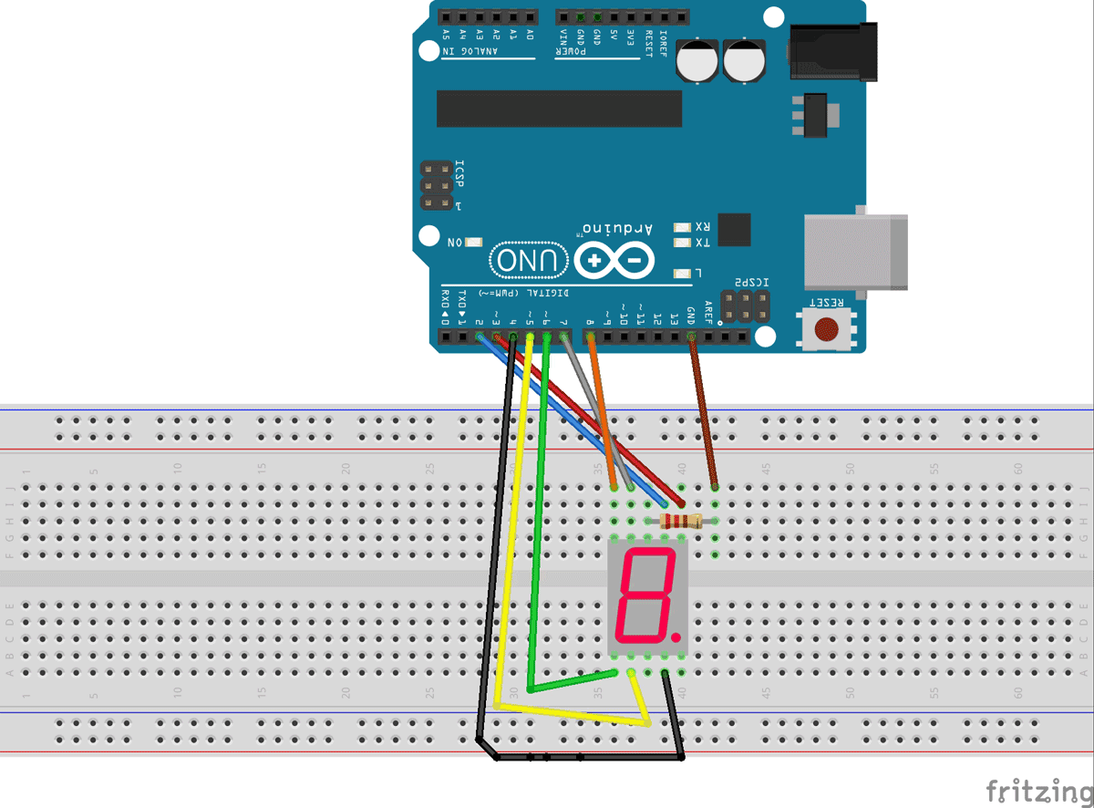

Slide 16
Thank you

